Slide 1
연구개발 일지
2023
이강우
ETRI

Slide 2
Common
Point, Size2d, Box, BGR, Image, Frame
Camera 관련
Camera(I), ImageCapture(I)
ImageProcessor, FrameProcessor(I)
Object detecting 관련
Detection, ObjectDetector(I), DetectingProcessor(→FrameProcessor)
Object tracking 관련
ObjectTracker(I), ObjectTrack, TrackState, TrackProcessor
TrackingPipeline(→FrameProcessor), TrackProcessor
Node 관련
EventQueue, EventListener(I), EventProcessor(→ EventQueue, EventListener)
TrackEventPipeline(→TrackProcessor, EventListener), Tracklet
ZonePipeline(→EventListener)

Slide 3
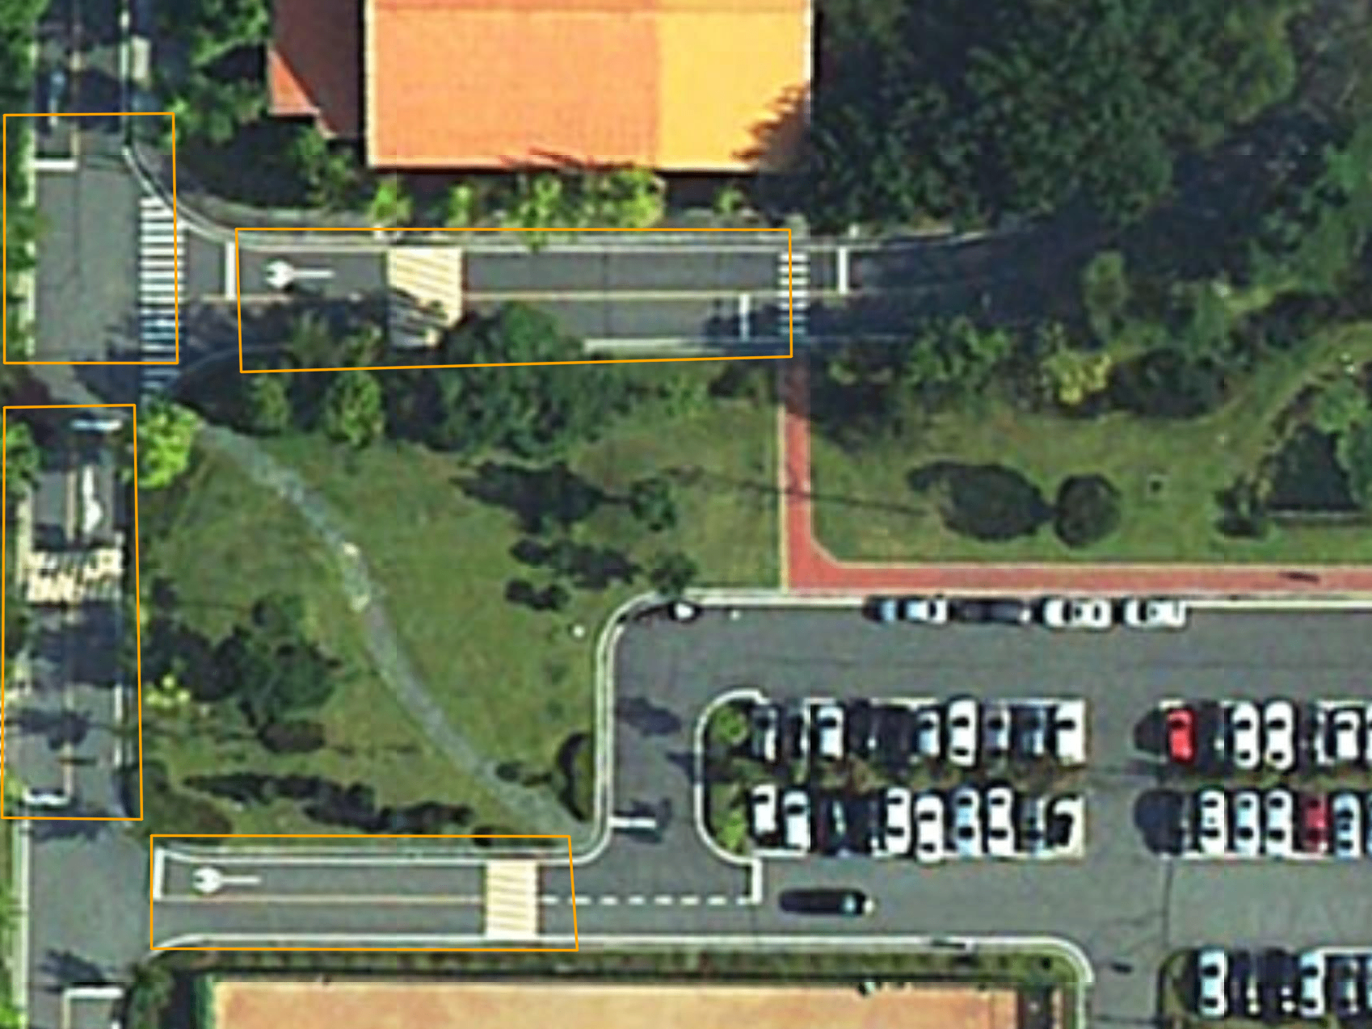
04
G
05
H
A
06
B
C
D
E
07
F

Slide 4
B
04
05
C
06
A
D
07
E

